Slide 1


Slide 2
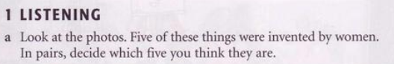

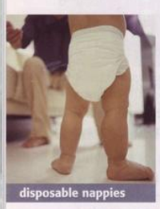

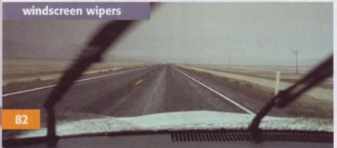






Slide 3
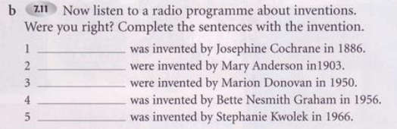

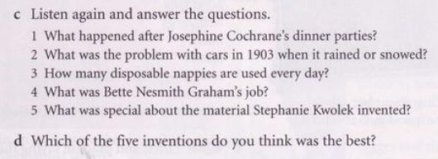
The dishwasher
The windscreen wiper
The disposable nappies
The tippex
The bullet-proof vest

Slide 4
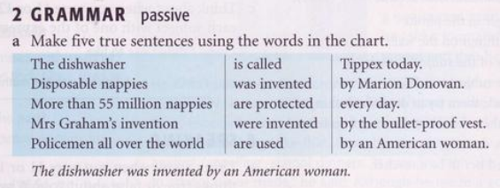
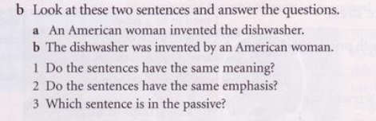

Slide 5
S + V +O
Active
S + Be + Vpp + by O
Passive

Slide 6
Subject | + to be (conjugated) | + past participle | + rest of sentence
Simple present S am/is/are Vpp
The house | is | cleaned | every day.
Present continuous S am/is/are + being Vpp
The house | is being | cleaned | at the moment.
Simple past S was/were Vpp
The house | was | cleaned | yesterday.
Past continuous S was/were + being Vpp
The house | was being | cleaned | last week.
Present perfect S has/have + been Vpp
The house | has been | cleaned | since you left.
Past perfect S had + been Vpp
The house | had been | cleaned | before they arrived.
Future S will be Vpp
The house | will be | cleaned | next week.
Future continuous S will be being Vpp
The house | will be being | cleaned | tomorrow.
Present conditional S would be Vpp
The house | would be | cleaned | if they had visitors.
Past conditional S would have been Vpp
The house | would have been | cleaned | if it had been dirty.
Inifinitive S modal verb be Vpp
The house | must be | cleaned | before we arrive.

Slide 7
Exercise 1: Change these sentences into passive voice
1. The waiter brings me this dish.
………………………………………………………………………………………………………………………………………………….
2. Our friends send these postcards to us.
………………………………………………………………………………………………………………………………………………….
3. Their grandmother told them this story when they visited her last week.
………………………………………………………………………………………………………………………………………………….
4. Tim ordered this train ticket for his mother.
………………………………………………………………………………………………………………………………………………….
5. She showed her ticket to the airline agent.
………………………………………………………………………………………………………………………………………………….
6. Jim baked this cake yesterday.
………………………………………………………………………………………………………………………………………………….
7. They are going to buy a new apartment next year.
………………………………………………………………………………………………………………………………………………….
8. The shop assistant handed these boxes to the customer.
………………………………………………………………………………………………………………………………………………….
9. The board awarded the first prize to the reporter.
………………………………………………………………………………………………………………………………………………….
10. Have you sent the Christmas cards to your family?
………………………………………………………………………………………………………………………………………………….
11. The committee appointed Alice secretary for the meeting.
………………………………………………………………………………………………………………………………………………….
12. Tom will give Anna a ride to school tomorrow.
………………………………………………………………………………………………………………………………………………….

Slide 8
Exercise 2: Change these questions into passive voice.
1. When will you do the work?
………………………………………………………………………………………...............
2. How are you going to deal with this problem?
…………………………………………………………………………………………………
3. How do you spend this amount of money?
…………………………………………………………………………………………………
4. Who are they keeping in the kitchen? …………………………………………………………………………………………………
5. How did the police find the lost man?
…………………………………………………………………………………………………
6. What books are people reading this year?
…………………………………………………………………………………………………
7. How did the police find the lost man?
…………………………………………………………………………………………………
8. Who looked after the children for you?
…………………………………………………………………………………………………
9. How long have they waited for the doctor?
…………………………………………………………………………………………………
10. Why didn’t they help him?
…………………………………………………………………………………………………

Slide 9
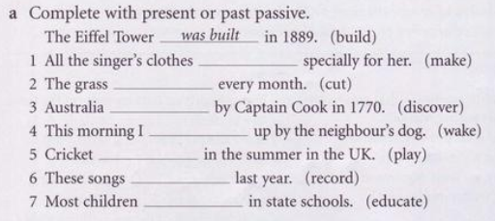
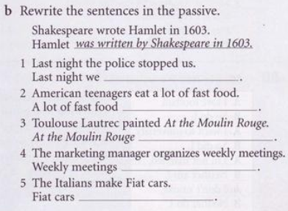

Slide 10
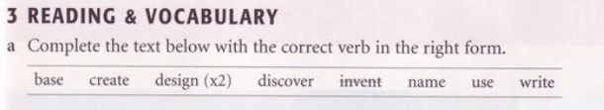
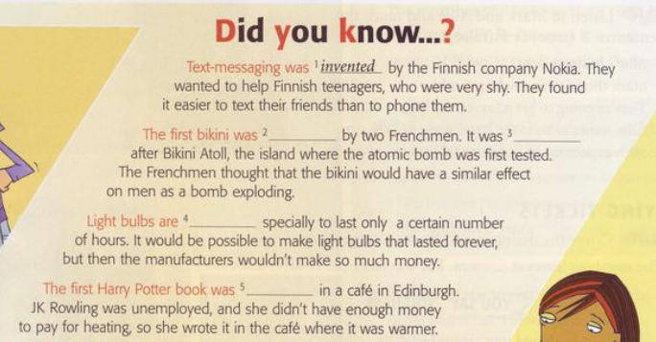
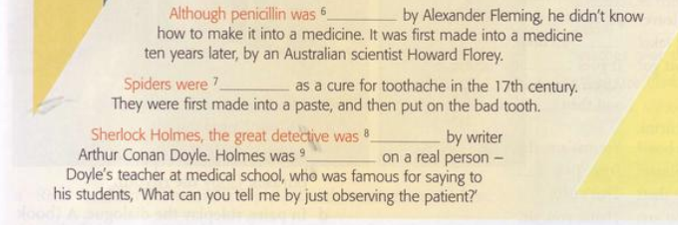

Slide 11
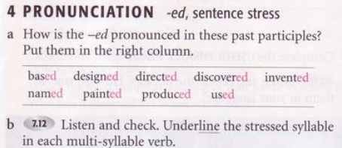
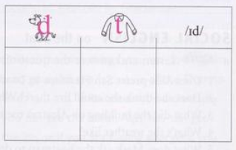
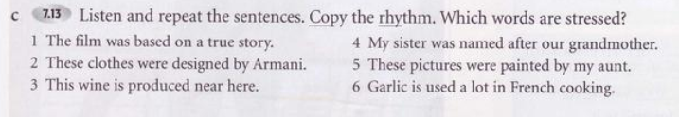

Slide 12
